Slide 1

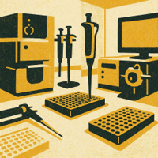
Proteomic Analysis Overview and Results
9/2/25
Notes:
Image source: AI-generated

Slide 2
Pre-Processing
Initial normalisation
Marie’s clean-up script
Missing data handling
Outlier removal
Log2 transformation
Imputation (downshifted)
Takes the observed distribution
Shifts downwards and adds random noise
Assumes missing-not-at-random (due to low abundance)
Notes:
Mass spectrometry (MS) is central to proteomics, enabling precise identification and quantification of proteins. Typical workflows include protein digestion into peptides, separation by liquid chromatography, ionization, and MS/MS fragment analysis. High-resolution MS instruments improve sensitivity and accuracy. Data-dependent acquisition (DDA) and data-independent acquisition (DIA) represent different strategies with trade-offs in depth and reproducibility.

Slide 3

Analyses
PCA and MANOVA
Creates linear combinations of original variables to maximise variance
Identifies if there’s a significant difference in mean between groups/conditions that isn't accounted for by variance
Is there a batch effect?
Are there likely to be significant results along the axes we’re looking at?
Limma
Effectively an adjusted ANOVA with empirical Bayes moderation
Identifies if there’s a significant difference in mean between groups/conditions that isn't accounted for by variance
Which proteins are significantly different in each comparison?
Logistic Regression
Creates an equation to predict which group a sample belongs to
Every protein is a variable, and its coefficient is learned from provided data (bigger coefficient = more significant indicator)
Which proteins are more significant in each comparison?
Next Steps
Batch correction with ComBat
Look at eigenvalues in PCA analysis to see which proteins contribute most to identified components
Notes:
Proteomics complements genomics, transcriptomics, and metabolomics by providing a snapshot of the actual functional molecules in the cell rather than potential capabilities encoded by DNA or RNA. While genomics reveals gene sequences, and transcriptomics profiles gene expression, proteomics measures protein levels and modifications, which often do not correlate directly with mRNA abundance. This makes proteomics indispensable for understanding functional biology and bridging the gap between genotype and phenotype.

Slide 4
Scripts and Tools
Analysis.py
Graphical user interface
Runs Limma and logistic regression
Paired or unpaired Limma
Flexible for new files/variable
Can choose input file/sheet
Can choose which tests to run
Can choose condition variable, columns to exclude, columns/values to filter by and to compare based on deltas
Next steps: integrate pre-processing
PCA.py
No user interface (just a script)
Runs PCA and ANOVA
Need to manually adjust values for new files/variables
Next steps: integrate into analysis.py
Notes:
Mass spectrometry (MS) is central to proteomics, enabling precise identification and quantification of proteins. Typical workflows include protein digestion into peptides, separation by liquid chromatography, ionization, and MS/MS fragment analysis. High-resolution MS instruments improve sensitivity and accuracy. Data-dependent acquisition (DDA) and data-independent acquisition (DIA) represent different strategies with trade-offs in depth and reproducibility.

Slide 5
Soluble PCA
Number of components to explain 95.0% of variance: 18
- PC1: 25.02%
- PC2: 15.10%
- PC3: 9.38%
- PC4: 7.20%
- PC5: 6.37%
- PC6: 4.55%
- PC7: 4.12%
- PC8: 3.66%
- PC9: 3.30%
- PC10: 2.84%
- PC11: 2.34%
- PC12: 2.14%
- PC13: 2.01%
- PC14: 1.85%
- PC15: 1.67%
- PC16: 1.35%
- PC17: 1.24%
- PC18: 1.15%
Total variance explained by 18 components: 95.28%
Notes:
Mass spectrometry (MS) is central to proteomics, enabling precise identification and quantification of proteins. Typical workflows include protein digestion into peptides, separation by liquid chromatography, ionization, and MS/MS fragment analysis. High-resolution MS instruments improve sensitivity and accuracy. Data-dependent acquisition (DDA) and data-independent acquisition (DIA) represent different strategies with trade-offs in depth and reproducibility.

Slide 6
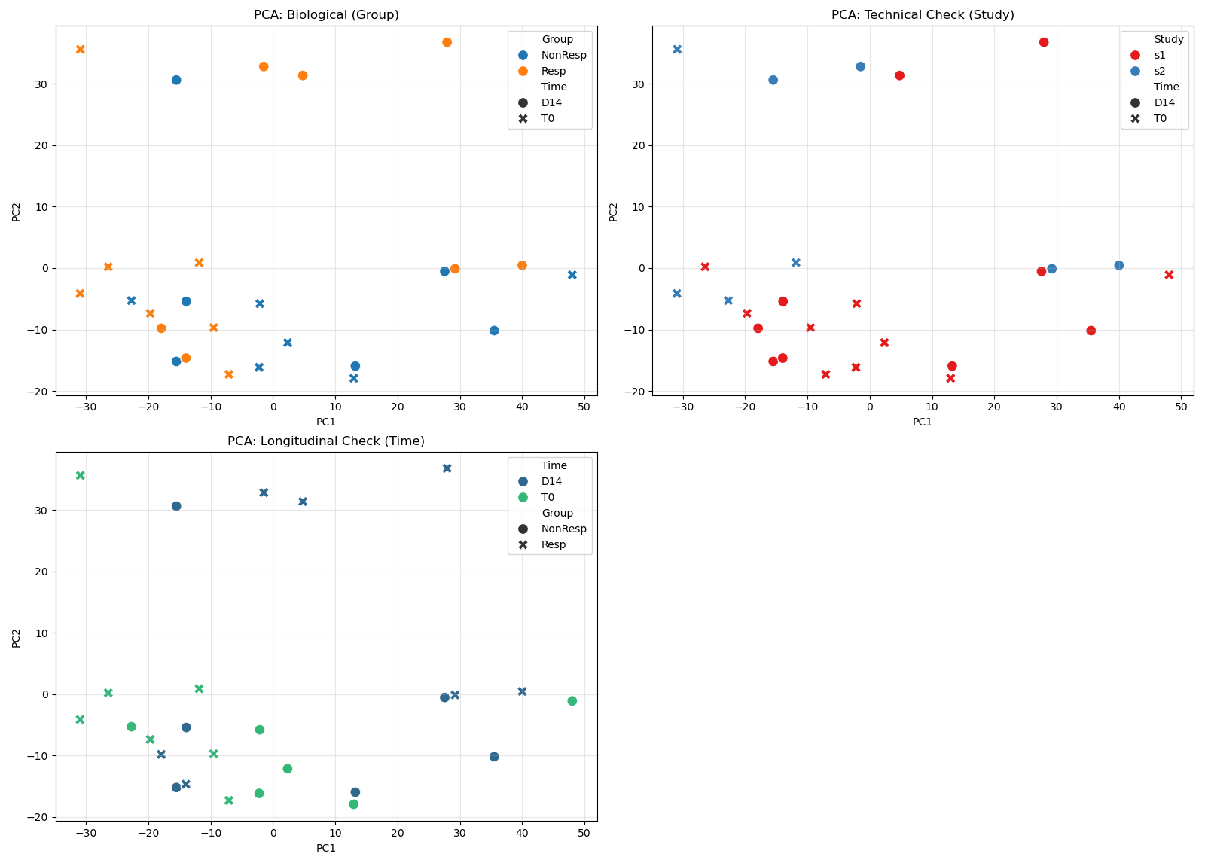
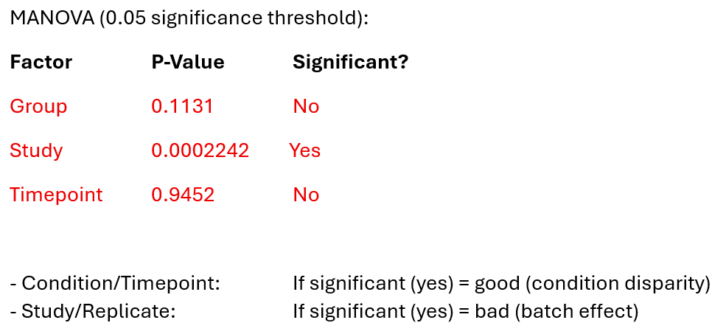
Soluble MANOVA
Notes:
Mass spectrometry (MS) is central to proteomics, enabling precise identification and quantification of proteins. Typical workflows include protein digestion into peptides, separation by liquid chromatography, ionization, and MS/MS fragment analysis. High-resolution MS instruments improve sensitivity and accuracy. Data-dependent acquisition (DDA) and data-independent acquisition (DIA) represent different strategies with trade-offs in depth and reproducibility.

Slide 7
Insoluble PCA
Number of components to explain 95.0% of variance: 15
- PC1: 28.50%
- PC2: 20.57%
- PC3: 13.08%
- PC4: 6.77%
- PC5: 5.45%
- PC6: 3.83%
- PC7: 3.61%
- PC8: 2.80%
- PC9: 2.30%
- PC10: 2.07%
- PC11: 2.02%
- PC12: 1.48%
- PC13: 1.27%
- PC14: 1.00%
- PC15: 0.92%
Total variance explained by 15 components: 95.68%
Notes:
Mass spectrometry (MS) is central to proteomics, enabling precise identification and quantification of proteins. Typical workflows include protein digestion into peptides, separation by liquid chromatography, ionization, and MS/MS fragment analysis. High-resolution MS instruments improve sensitivity and accuracy. Data-dependent acquisition (DDA) and data-independent acquisition (DIA) represent different strategies with trade-offs in depth and reproducibility.

Slide 8
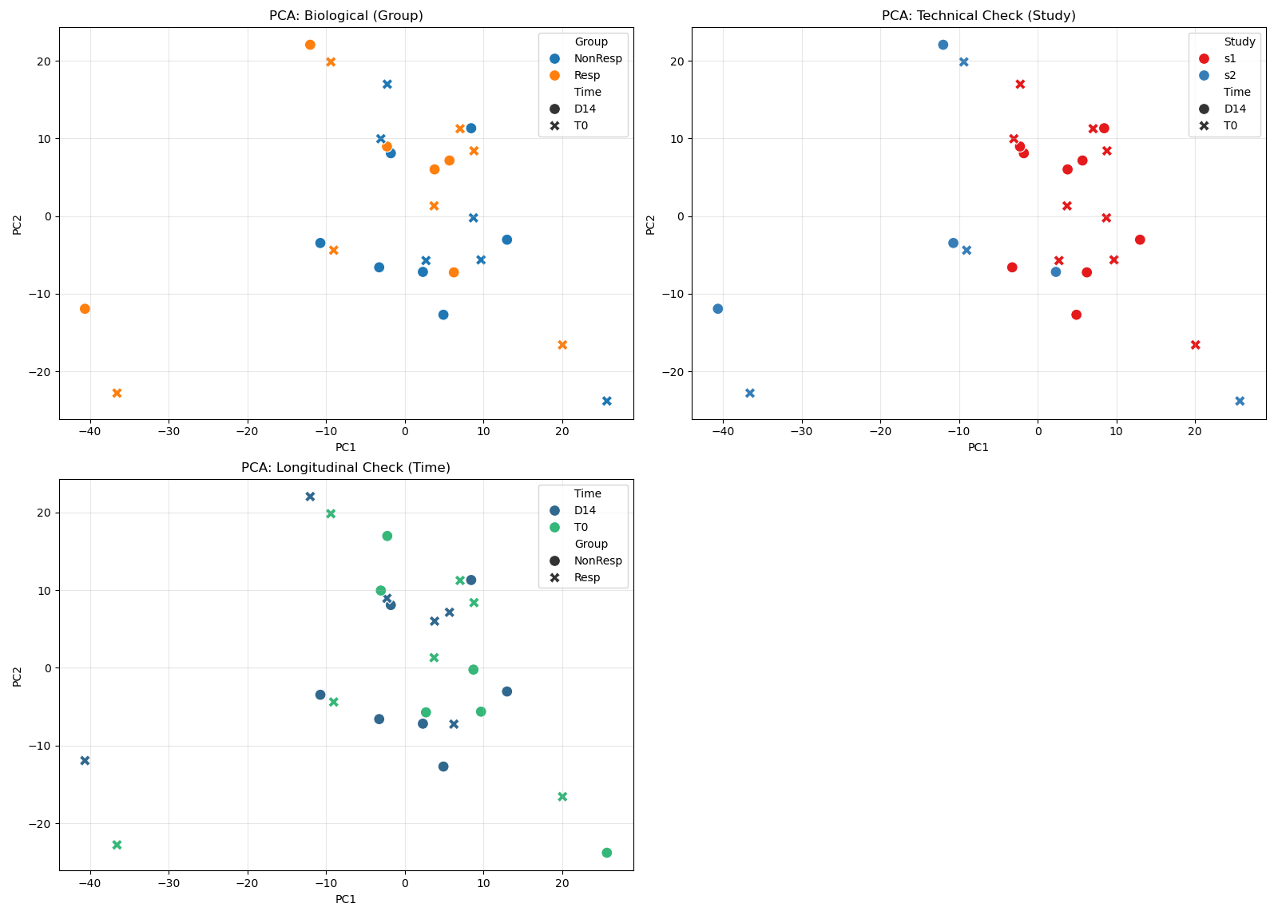
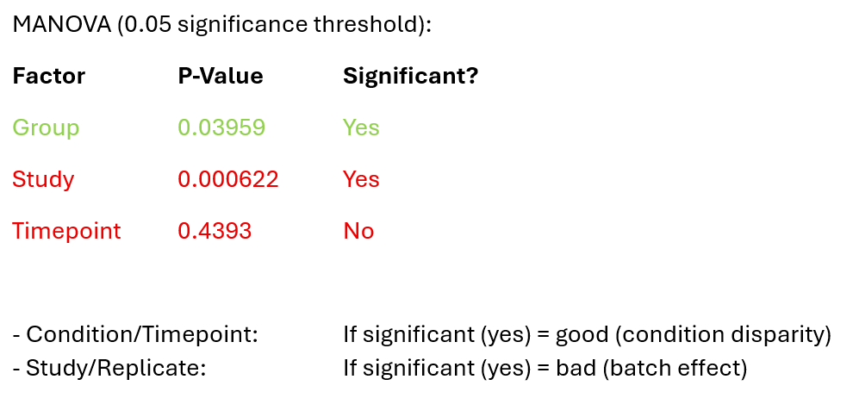
Insoluble MANOVA
Notes:
Mass spectrometry (MS) is central to proteomics, enabling precise identification and quantification of proteins. Typical workflows include protein digestion into peptides, separation by liquid chromatography, ionization, and MS/MS fragment analysis. High-resolution MS instruments improve sensitivity and accuracy. Data-dependent acquisition (DDA) and data-independent acquisition (DIA) represent different strategies with trade-offs in depth and reproducibility.

Slide 9
SPE PCA
Number of components to explain 95.0% of variance: 18
- PC1: 22.45%
- PC2: 17.40%
- PC3: 9.68%
- PC4: 6.69%
- PC5: 5.80%
- PC6: 5.22%
- PC7: 3.83%
- PC8: 3.35%
- PC9: 3.16%
- PC10: 2.82%
- PC11: 2.72%
- PC12: 2.41%
- PC13: 2.08%
- PC14: 1.80%
- PC15: 1.63%
- PC16: 1.52%
- PC17: 1.33%
- PC18: 1.16%
Total variance explained by 18 components: 95.03%
Notes:
Mass spectrometry (MS) is central to proteomics, enabling precise identification and quantification of proteins. Typical workflows include protein digestion into peptides, separation by liquid chromatography, ionization, and MS/MS fragment analysis. High-resolution MS instruments improve sensitivity and accuracy. Data-dependent acquisition (DDA) and data-independent acquisition (DIA) represent different strategies with trade-offs in depth and reproducibility.

Slide 10
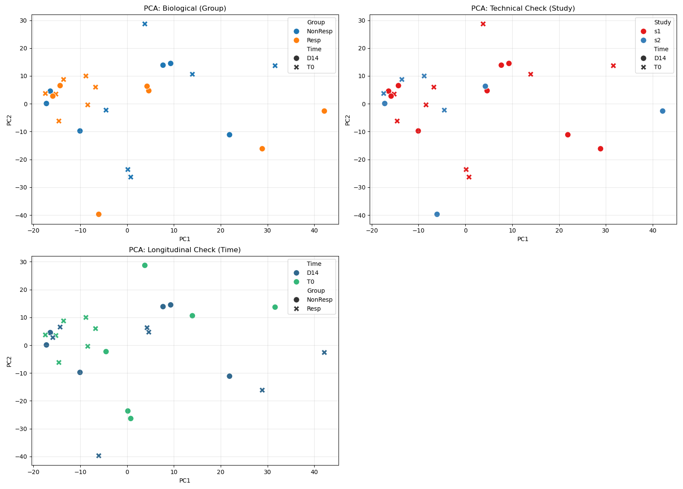
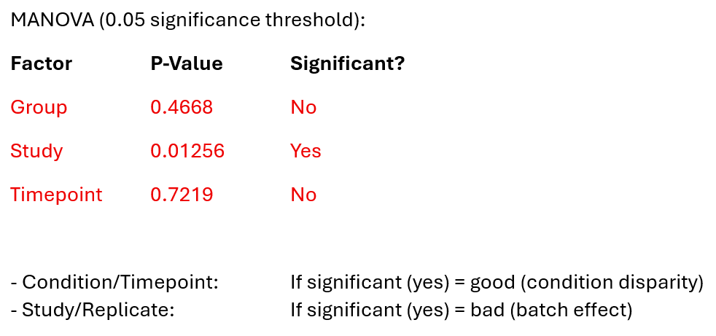
SPE MANOVA
Notes:
Mass spectrometry (MS) is central to proteomics, enabling precise identification and quantification of proteins. Typical workflows include protein digestion into peptides, separation by liquid chromatography, ionization, and MS/MS fragment analysis. High-resolution MS instruments improve sensitivity and accuracy. Data-dependent acquisition (DDA) and data-independent acquisition (DIA) represent different strategies with trade-offs in depth and reproducibility.

Slide 11
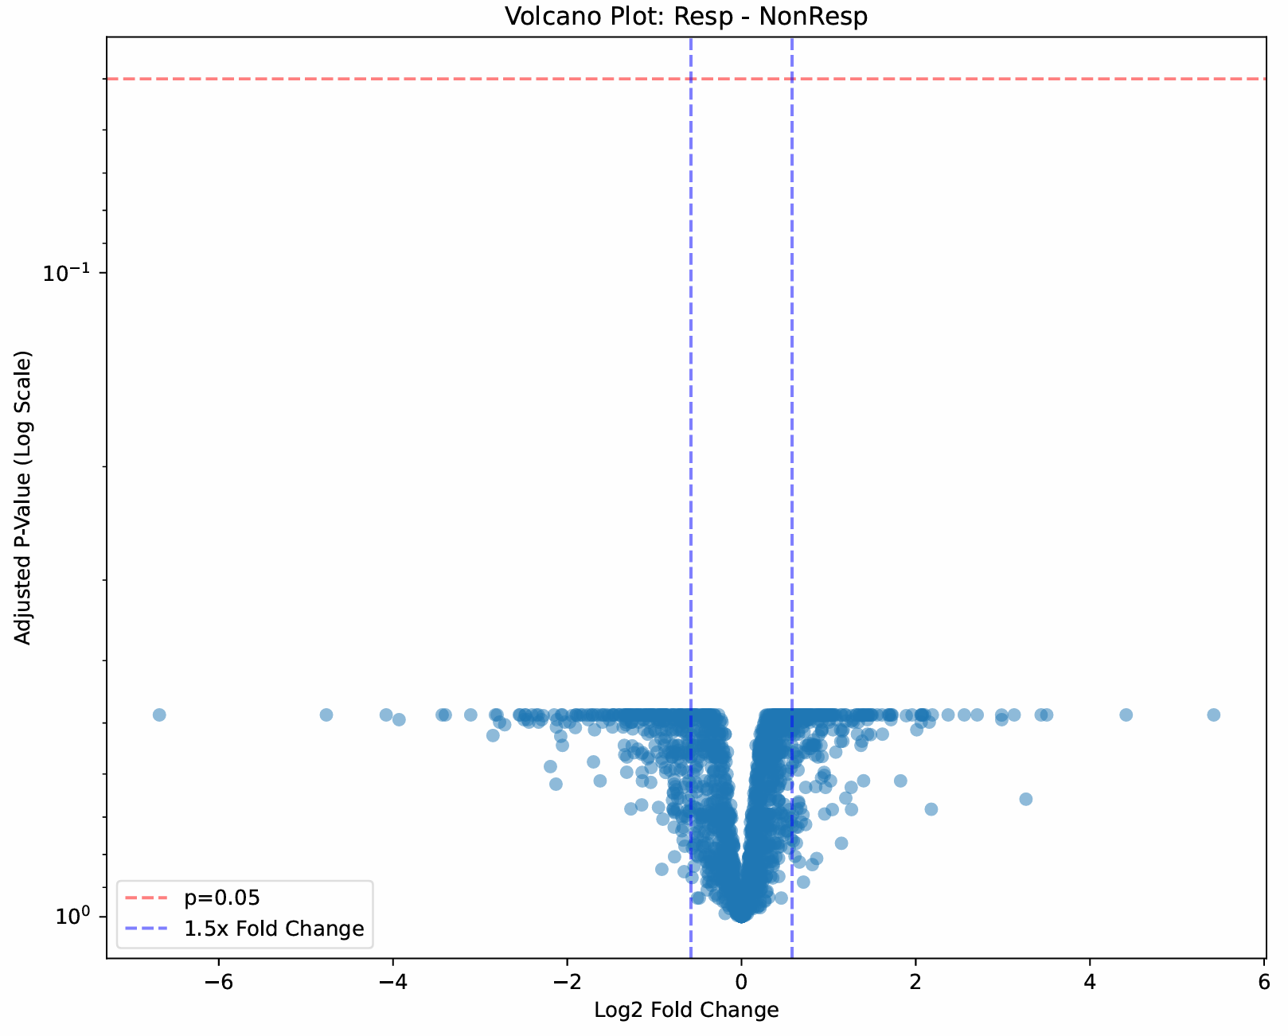
Soluble Limma Comparisons
Longitudinal Comparison: D0 vs D14 Responders
Proteins analysed (after filtering): 1990
Proteins with significant raw p-values: 338
Proteins with significant adjusted p-values: 0
Group Comparison: D14 Responders vs Non-Responders
Proteins analysed (after filtering): 1990
Proteins with significant raw p-values: 27
Proteins with significant adjusted p-values: 0
Delta Comparison: Difference from D0 to D14 in Responders vs Non-Responders
Proteins analysed (after filtering): 1990
Proteins with significant raw p-values: 161
Proteins with significant adjusted p-values: 0
Baseline Group Comparison: D0 Responders vs Non-Responders
Proteins analysed (after filtering): 1990
Proteins with significant raw p-values: 192
Proteins with significant adjusted p-values: 0
Delta comparison
Notes:
Mass spectrometry (MS) is central to proteomics, enabling precise identification and quantification of proteins. Typical workflows include protein digestion into peptides, separation by liquid chromatography, ionization, and MS/MS fragment analysis. High-resolution MS instruments improve sensitivity and accuracy. Data-dependent acquisition (DDA) and data-independent acquisition (DIA) represent different strategies with trade-offs in depth and reproducibility.

Slide 12
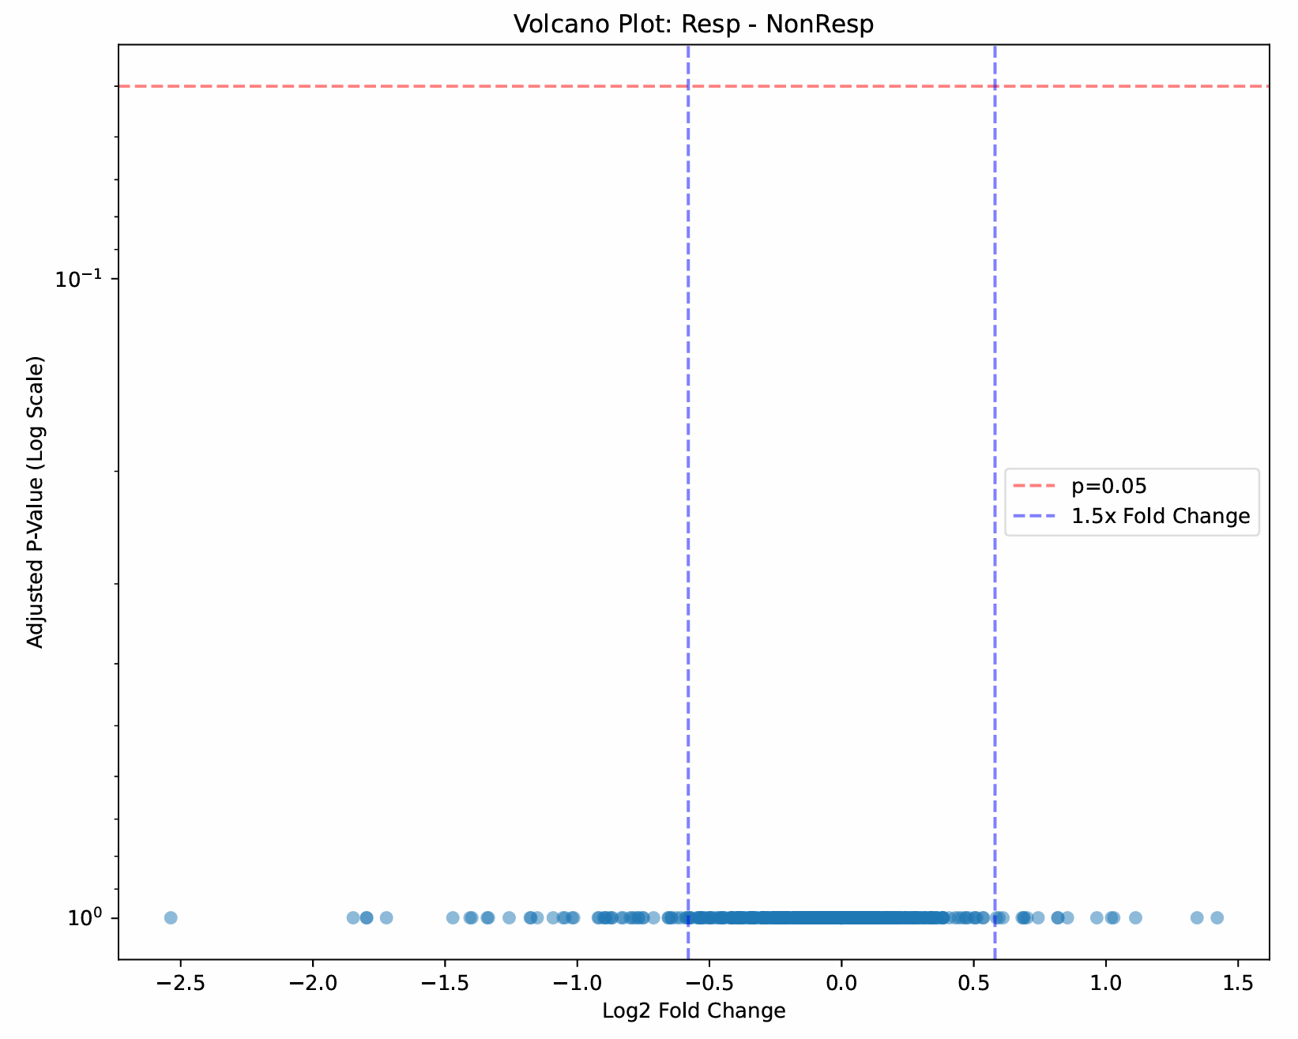
Insoluble Limma Comparisons
Longitudinal Comparison: D0 vs D14 Responders
Proteins analysed (after filtering): 700
Proteins with significant raw p-values: 17
Proteins with significant adjusted p-values: 0
Group Comparison: D14 Responders vs Non-Responders
Proteins analysed (after filtering): 700
Proteins with significant raw p-values: 20
Proteins with significant adjusted p-values: 0
Delta Comparison: Difference from D0 to D14 in Responders vs Non-Responders
Proteins analysed (after filtering): 700
Proteins with significant raw p-values: 5
Proteins with significant adjusted p-values: 0
Baseline Group Comparison: D0 Responders vs Non-Responders
Proteins analysed (after filtering): 700
Proteins with significant raw p-values: 10
Proteins with significant adjusted p-values: 0
Delta comparison
Notes:
Mass spectrometry (MS) is central to proteomics, enabling precise identification and quantification of proteins. Typical workflows include protein digestion into peptides, separation by liquid chromatography, ionization, and MS/MS fragment analysis. High-resolution MS instruments improve sensitivity and accuracy. Data-dependent acquisition (DDA) and data-independent acquisition (DIA) represent different strategies with trade-offs in depth and reproducibility.

Slide 13
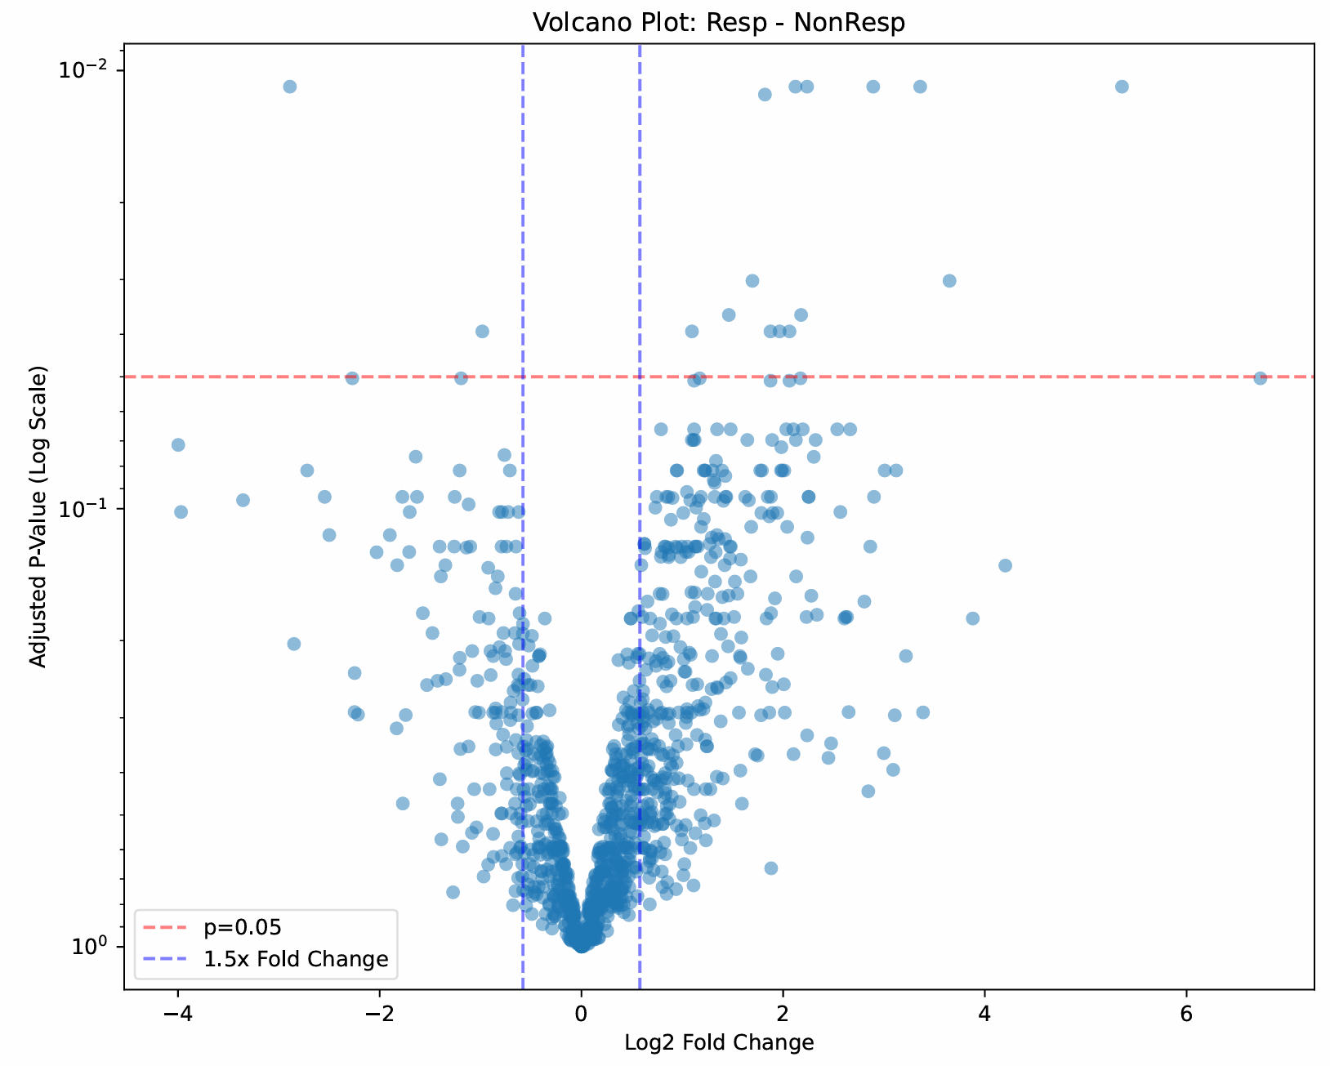
SPE Limma Comparisons
Longitudinal Comparison: D0 vs D14 Responders
Proteins analysed (after filtering): 1162
Proteins with significant raw p-values: 94
Proteins with significant adjusted p-values: 0
Group Comparison: D14 Responders vs Non-Responders
Proteins analysed (after filtering): 1162
Proteins with significant raw p-values: 10
Proteins with significant adjusted p-values: 0
Delta Comparison: Difference from D0 to D14 in Responders vs Non-Responders
Proteins analysed (after filtering): 1162
Proteins with significant raw p-values: 156
Proteins with significant adjusted p-values: 0
Baseline Group Comparison: D0 Responders vs Non-Responders
Proteins analysed (after filtering): 1162
Proteins with significant raw p-values: 240
Proteins with significant adjusted p-values: 16
Baseline comparison
Notes:
Mass spectrometry (MS) is central to proteomics, enabling precise identification and quantification of proteins. Typical workflows include protein digestion into peptides, separation by liquid chromatography, ionization, and MS/MS fragment analysis. High-resolution MS instruments improve sensitivity and accuracy. Data-dependent acquisition (DDA) and data-independent acquisition (DIA) represent different strategies with trade-offs in depth and reproducibility.

Slide 14
Soluble Logistic Regression
Group Comparison: D14 Responders vs Non-Responders
Accuracy: 0.6154
F1 Score: 0.6667
Confusion Matrix (Rows=Actual, Cols=Predicted):
[[3 3]
[2 5]]
Best Regularization Strength (C): 2.782559402207126
Best L1 Ratio: 0.95
36 proteins selected (have coefficients)
Results potentially meaningful
Baseline Group Comparison: D0 Responders vs Non-Responders
Accuracy: 0.8462
F1 Score: 0.8571
Confusion Matrix (Rows=Actual, Cols=Predicted):
[[5 1]
[1 6]]
Best Regularization Strength (C): 0.3593813663804626
Best L1 Ratio: 0.1
257 proteins selected
Results potentially meaningful
Notes:
Mass spectrometry (MS) is central to proteomics, enabling precise identification and quantification of proteins. Typical workflows include protein digestion into peptides, separation by liquid chromatography, ionization, and MS/MS fragment analysis. High-resolution MS instruments improve sensitivity and accuracy. Data-dependent acquisition (DDA) and data-independent acquisition (DIA) represent different strategies with trade-offs in depth and reproducibility.

Slide 15
Insoluble Logistic Regression
No panel of proteins found to generate an accurate model
Notes:
Mass spectrometry (MS) is central to proteomics, enabling precise identification and quantification of proteins. Typical workflows include protein digestion into peptides, separation by liquid chromatography, ionization, and MS/MS fragment analysis. High-resolution MS instruments improve sensitivity and accuracy. Data-dependent acquisition (DDA) and data-independent acquisition (DIA) represent different strategies with trade-offs in depth and reproducibility.

Slide 16
SPE Logistic Regression
Longitudinal Comparison: D0 vs D14 Responders
Accuracy: 0.5714
F1 Score: 0.5714
Confusion Matrix (Rows=Actual, Cols=Predicted):
[[4 3]
[3 4]]
Best Regularization Strength (C): 0.046415888336127774
Best L1 Ratio: 0.1
64 proteins selected
Results potentially meaningful
Delta Comparison: Difference from D0 to D14 in Responders vs Non-Responders
Accuracy: 0.6154
F1 Score: 0.6667
Confusion Matrix (Rows=Actual, Cols=Predicted):
[[3 3]
[2 5]]
Best Regularization Strength (C): 0.046415888336127774
Best L1 Ratio: 0.1
74 proteins selected
Results potentially meaningful
Baseline Group Comparison: D0 Responders vs Non-Responders
Accuracy: 0.8462
F1 Score: 0.8750
Confusion Matrix (Rows=Actual, Cols=Predicted):
[[4 2]
[0 7]]
Best Regularization Strength (C): 2.782559402207126
Best L1 Ratio: 0.1
Selected 397 proteins
Results potentially meaningful
Notes:
Mass spectrometry (MS) is central to proteomics, enabling precise identification and quantification of proteins. Typical workflows include protein digestion into peptides, separation by liquid chromatography, ionization, and MS/MS fragment analysis. High-resolution MS instruments improve sensitivity and accuracy. Data-dependent acquisition (DDA) and data-independent acquisition (DIA) represent different strategies with trade-offs in depth and reproducibility.

Slide 17
Insoluble PCA
Number of components to explain 95.0% of variance: 15
- PC1: 28.50%
- PC2: 20.57%
- PC3: 13.08%
- PC4: 6.77%
- PC5: 5.45%
- PC6: 3.83%
- PC7: 3.61%
- PC8: 2.80%
- PC9: 2.30%
- PC10: 2.07%
- PC11: 2.02%
- PC12: 1.48%
- PC13: 1.27%
- PC14: 1.00%
- PC15: 0.92%
Total variance explained by 15 components: 95.68%
Notes:
Mass spectrometry (MS) is central to proteomics, enabling precise identification and quantification of proteins. Typical workflows include protein digestion into peptides, separation by liquid chromatography, ionization, and MS/MS fragment analysis. High-resolution MS instruments improve sensitivity and accuracy. Data-dependent acquisition (DDA) and data-independent acquisition (DIA) represent different strategies with trade-offs in depth and reproducibility.

